Slide 1
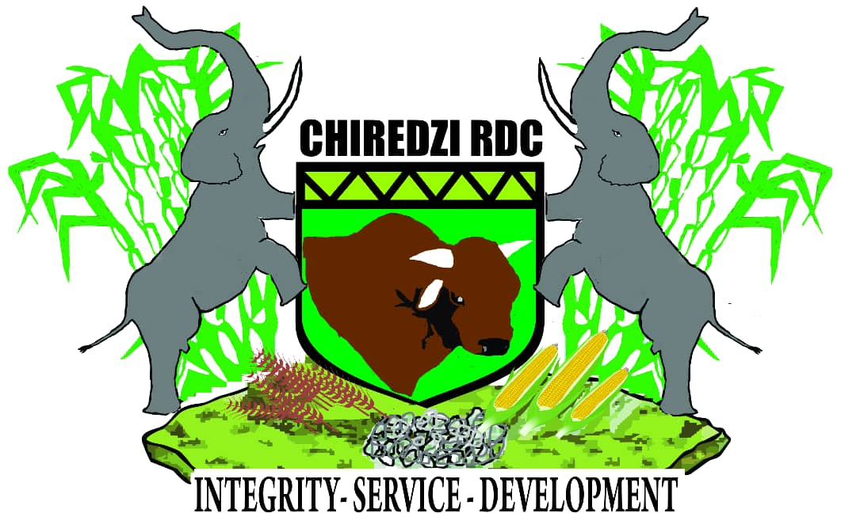
CHIREDZI RDC
LOCAL ECONOMIC DEVELOPMENT

Slide 2
Historical Background
Local Government in Zimbabwe has been in existence since the 18th century, in the form of traditional structures led by then Kings, Chiefs, Headmen, and Village Heads. The advent of colonial rule in the last half of the 19th century, brought in the formal local government system modelled along the European taste. This system of local government was premised along racial lines, and had a dual funding mechanism to suite the then regime. Chiredzi District by then Ndanga Tribal Trust Land was led by Chief Ndanga and at independence in 1980, Zimbabwe inherited the same system, and was quick to do away with this discriminatory local government structure.
In the post independence era, rural councils were introduced covering the commercial farming areas but only permitted land owners to vote. Rural councils were interested in the provision of roads within the farming areas and the provision of services to the small urban centres within their boundaries that saw the establishment of Gaza Khomanani District Council in 1982.

Slide 3
continue…
In 1988 the Rural District Act 8/1988 (Chapter 29: 13) was promulgated and it unified The District and Rural Councils into the single system of rural administration for rationalization of local government in the rural areas.
The amalgamation of the Rural and District Councils was seen as necessary to dismantle the former racially based local government system and creation of the rural areas local government system that would promote nation building through interaction across the colour line. As a result of the 1988 legislative changes, Zimbabwe adopted a bipartite system of local government composed of Urban and Rural District Councils
Later on in 1990, the Gaza Khomanani District Council acquired the status of appropriate authority.
In 1993 the Republic of Zimbabwe promulgated the amalgamation of district councils and rural district councils which resulted in the amalgamation of two district councils, namely Gaza Khomanani District Council and Chiredzi Rural Council to Chiredzi Rural District Council.

Slide 4
continue….
The Constitution of Zimbabwe Part 3 Section 274 on Local Government provides the existence of Urban Local and Rural Local Authorities to represent and manage the affairs of people in urban and rural areas throughout Zimbabwe. In Zimbabwe Rural Local Authorities are constituted in terms of the Rural District Councils Act Chapter 29:13. The constitution is so clear about the mandate and roles of local authorities with regards to the provision of service delivery.
Local government is a crucial facet and third tier of government and as such sufficient investment has to be made into this level to ensure sustainable development, sound and sustainable service delivery underpinned by active community participation. It is that level of government that is closest to the people, as it relates to structures, institutions and process of local government, which happen at a local level within the geographical vicinity of residents. Local government institutions play a key role in both urban and rural development and in socio and economic development.

Slide 5
continue
TRIBE
The District is a rainbow of cultures as it houses more than five (5) tribes though the first to settle in the Lowveld Province the Pfumbi Tribe followed by the Shangani Tribe and the Ndau Tribe. The Ndebele and the Shona Tribes came to settle in Chiredzi as a result of the displacements caused by the Shona and Ndebele Uprisings.
Traditionally our forefathers enjoyed trade with the Portuguese from Mozambique and there was migration into South Africa (Wenela) where they worked in mines.

Slide 6
Heritage Values
1. Sacred Areas
The District is dotted with such areas throughout the whole District. This can be partly due to the greater cultural Diversity in the District. The fact that we have five different tribes in the District could be the pointer as to why we have more of such places.
In Gonarezhou- There are several places where the local community go into the protected area to perform rain making ceremonies such as Nyavasikana, areas close to Mabalauta.
Bendezi Mountain.- The Chilonga clan which was once occupiers of the land before the coming in of the Sugarcane production and construction of Mteri Dam annually visit the area for rain making and other ceremonies.

Slide 7
continue…..
Triangle Mill.- The Mukanga and the Banda families perform various rituals around the mill.
Chibwedziva- Literally meaning a pool around a stone. In the olden days; drums beating, cattle herding, voices and mermaid could be seen and heard. The baobab tree on the site, a black and red cloth cloud always be seen tied to the tree branches. An encounter with a hairy snake is said to have been a common site.
Pesvi Gorge, Mashawi hot springs, Dombo ravasikana, hamba komba just but to mention a few are some of the many sacred places in the District. A lot more areas could be existing in the District, however the local shangaan and ndau community are generally secretive. They can not easily divulge scared secrets to strangers.

Slide 8
2. Traditional Ceremonies
Various ceremonies are held annually or periodically the most common are not limited to
Shangaan cultural festival.-This is a was born out of the four chiefs namely Sengwe, Tshovani, Gudo and Mahenye (on Chipinge side). This was meant to be an annual event rotating amongst aforementioned traditional chiefs.
The main purpose of the event was for local communities to meet and celebrate culture through music and dance. This was supposed to guard against fading and erosion of culture through western influences.
b) Greater Limpopo cultural fair-This is an annual event which is held in Matibi 2 to showcase cultural and heritage. The function is held under centre for cultural development initiatives.
c) Machangaan festival-The festival is held periodically with Malipati Development Trust driving the festival

Slide 9
continue.......
Initiation ceremonies. - In the Shangaan culture both man and women are initiated into both manhood and womanhood. This is supposed to be carried out during winter months thus from April to August.
The Varemba thus the zhous is still yet another clan which is into initiation of both boys and girls.
Scared days or Months.- This varies with the clans, tribes and chiefdom, Wednesdays are usually used a Chisi chamambo. This is the day when the traditional courts are conducted
3. Cultural Values
The cultural values vary greatly among the various tribal group. However for some communities it seems there is cultural pollution amongst the various tribes. South Africa culture and values are greatly polluting the local cultural people especially those on the southern region of the District.

Slide 10
Geographical Location And Size
Chiredzi District is located in the South-Eastern region of Zimbabwe sharing borders with Mozambique and South Africa. Sharing Districts with Chipinge, Bikita, Zaka, Masvingo, Chivi, Mwenezi and Beitbridge.
The total area of the District is about 36000 km²
The district shares borders with Mozambique and South Africa which enable the three governments to amalgamate some of the world’s largest wildlife sanctuaries, Thus Limpopo National Park, Kruger National Park and Gonarezhou National Park for Mozambique, South Africa and Zimbabwe respectively.
The District is characterised by very high summer temperatures and cool winters with an annual average temperature of about 28˚C.
The District is in the Natural Region V, according to the agro-ecological zonation of 1969 by Vincent and Thomas (Chikodzi & and Mutowo, 2012).

Slide 11
Map 1. sharing borders with Mozambique and South Africa.

Slide 12
Geographical continue
The average annual rainfall ranges from 450mm – 500mm. The seasons are usually characterised by sporadic mid-season droughts and severe mid-season long dry spells (Jiri, et al., 2015).
In Chiredzi, groundwater mainly lies in five aquifers, of which the top layer is for the most part sufficiently protected. The total groundwater volume in the earth is approximately 2000 km³.
The area is less suitable for crop production save for early maturing short seasoned crops.
This mostly have low yielding capacity. In most instances the District has one good season in every 5 years. The problem has been further exacerbated by climate change.
The district has sufficient surface water sources and water bodies throughout the year

Slide 13
Demography
The District habours a total population of about 282 653 people basing on the estimation growth rate of 2.5% to 2012 Census results of 275 759
females 146 414 being 51.8% and
males 136 239 being 48.2 %.
The district has about 64 134 households with average size of 4.3.
Dependency ratios
Old age dependency ratio above 64 years of age is 1:16
Child age ratio below 14 is 1:1.08
Age dependency ratio below 14 and above 64 is 1:1.01
Poverty and inequality levels
Poverty level is 67.2% , the extreme poverty level is 28.7%
Percentage of poor households 20.6%

Slide 14
continue….
Health and education indicators
The Crude death rate is 9.2% per General fertility rate of 152 births
92% of the whole population is literate
Mobility and Migration
Based on current estimation population size, about 7 % from other districts within the same province, 3 % from other provinces that are in chiredzi district.
Working age youth and men have migrated to South Africa and Mozambique in search of employment
Size, Age and Gender distribution of the local labour forces
Economically Active Persons are 40% of the population that is 113 061 people.
Paid employee 29.5% , Employer 0.3%, Own account worker 51.4%, Unpaid family worker 12.2% of the economically active people.

Slide 15
Activity Rate by Age Group
Age | People between age range | Active Rate
15-19 | 27882 | 46.3
20-24 | 21553 | 74
25-29 | 21943 | 81.2
30-24 | 19166 | 84.8
35-39 | 16452 | 87.9
40-44 | 10541 | 89.6
45-49 | 6237 | 88.8
50-54 | 7628 | 87.9
55-59 | 5706 | 87.1
60-64 | 4616 | 83.1
65+ | 4921 | 57

Slide 16
continue….
Skills and Education levels
8.5 % never attended school
21.3% attained primary level, 5.8 % attained secondary level and 3% tertiary level
Unemployment figures
Looking for work/unemployed 6.6% of economically active people that is 7462 people.
Labour Stability
About 37.29 % of the whole population is employed.
Of the 37.29% of the population employed; 79 % is in agriculture occupations, 5.2 % in services occupations, 1.1 % in manufacturing , 1.9 law and security, 1.6 % in education and 11.2% in other occupations.

Slide 17
Corporate Governance
Vision- Excellent service delivery and higher standards of living for our people by 2023
Mission- To improve the standard of living through building diverse community livelihoods in a sustainable manner fostering partnerships in all sectors of the economy.
Core Values- Accountability, Development Oriented, Integrity, Team Work and Gender Sensitivity

Slide 18
Municipal Landscape
Council consists of 8 committees
Finance
Staffing
Technical Services
Community Service
Environment
Campfire Sub-Committee
Audit
RDDC (Rural District Development Committee) which is responsible for the development of the committee
The district houses’ Chiredzi Town Council with 6 wards and is highly urbanized and populated. and also industrialised
Wards- The district comprises of 32 wards represented by an elected Councillor at Council
Growth point- we have got 1 growth point which is Chikombedzi

Slide 19
Council Arrangement
1. Council Structure
CRDC is headed by the Chief Executive Officer who reports to the Policy Making Board (Councillors) who oversees all the operations in the district.
Below the Chief Executive Officer are the Executive Officers who are Head of Departments in the organization followed by their assistance.
These Head of Departments oversees the operations in their thematic area, and reports to the Chief Executive Officer.
The Policy Making Board, the Chief Executive Officer and the Executive Officers of the organization are responsible for decision making and policy formulation

Slide 20
Continue…..
Policies And Regulations
Constitution of Zimbabwe [Section 274]
Public Finance Management Act (Chapter 22:19)
Regional Town and Country Planning Act, [Chapter 29:12]
Public Health Act [Chapter 15:09]
Labour Act [Chapter 28:01]
Cemeteries Act [Chapter 5:04]
Education Act [Chapter 25:04]
Food and Food Standards Act [Chapter 15:04]
Housing and Building Act [Chapter 22:07]
Housing Standards Control Act [Chapter 20:08]
Land Acquisition Act [Chapter 20:10]
Land Survey Act [Chapter 20.12]
Liquor Act [Chapter 14:12]
Rural District Act

Slide 21
2. 1 Economic Development Committees
The RDDC( Rural District Development committee) is responsible for the developmental growth of the district as whole.
We also have Ward Development Committees at ward level which is led by the councillor and
Village development committee which is led by the headmen.
3. Financial Position
Budget size- 2020 Financial Year $26 million dollars
Audited Accounts- 2019
Collection levels- 76 % of budget and 80% of billed income
Asset base- $96 million
Revenue sources- land and property tax, consumptive conservation, land sale, licenses, partnerships and land levies

Slide 22
1. Main Activities
Spatial Development Overview
Retail - Depends heavily on goods imported and smuggled from South Africa and Mozambique. The District is laced with informal traders. We also have N Richards, Simrac Gains and Metro Peach as leading wholesalers.
Industry- Tongaat Hullets is the major industry in the District being the 2nd largest employer after Government employing about 14 000 workers.
Mining- Chiredzi District is not a major mining District; however it is littered with mushrooming small scale and informal mines. Mines include Chisambiji coal mine, Verify Engineering and whole lot of Quarry mines to supply Tongaat Hullets with quarry for Canal construction.

Slide 23
2. Land Use And Land Use Patterns
Extensive dry land farming, particularly the production of drought tolerant short seasoned varieties such small grains. The District is in Natural 5 which is characterised by sporadic droughts , frequent droughts and prolonged mid season dry spells (Gambiza & Nyama, 2006)..
Extensive livestock rearing - The District has more than 198 000 herd of cattle. Livestock is mainly kept under subsistence cattle ranching most commercial cattle ranches were either converted to wildlife sanctuaries or the gazzetted for human settlement under the agrarian land reform of 2000, save valley and buffalo Range and others respectively. However, cattle ownership is very complex at household level.
Extensive Wildlife ranching -The area much more suitable for wildlife ranching given the various wildlife sanctuaries Malilangwe conservancy, Save valley conservancy (largest privately owned conservany in the world) , Chiredzi River conservancy, Gonarezhou National Park and corridors such as the Sengwe-Tshipise corridor.

Slide 24
continue....
Wildlife tourism ventures. The District is the home to the mighty Gonarezhou which is the second largest National park. Save Valley conservancy is the largest privately owned protected area in the world. Malilangwe Trust has proved to be a world class holiday destination given the caliber of guests or tourists who has been hosted there not limited to Bill Gates, Shakira just to mention a few.
There is also Chiredzi River conservancy and an endless list other small privately owned protected areas dotted throughout the whole District.
Commercial farming(sugarcane production)
The District is also part of the Great Limpopo trans-frontier conservation area (GLTFCA). The GLTFCA was formed through amalgamation of Kruger national Park in South Africa, Limpopo National Park in Mozambique and Gonarezhou National park in Zimbabwe .

Slide 25
Map.3 Great Limpopo Trans-frontier conservation Area

Slide 26
3. Functional Areas & Land Use.
Residential/settlement areas- Settlement is broadly categorized into Communal and Resettlement for the newly acquired land post the 2000 land invasion and land redistribution. We have A1 and A2 farmers
Natural Dams - Due to extensive river network in the District which makes it have quite a number of natural pools and Gorges such as Pesvi Gorge, Chivilila Gorge, Chipinda pools, Ross pool just but to mention a few. Mashawi hotspring is still yet another spectacular form of a natural area
Dams- The District is serviced by quite a number of Dams not limited to Mteri, Jiri, Bangala, Manjerenje, Masukwe, Chikombedzi Gurungweni, Gungwa

Slide 27
Infrastructure
The District has both Air, Rail and Road access
Road network - is extensive in the District however, the greater part is untarred. Chilonga Bridge remains a thorn in the flesh for the Matibi 2 communities, Once we have incessant rains the river becomes impassable resorting homemade boats as the only option to cross the mighty flooded Runde river.
Total Road network 2300km, Gazzetted roads 1800km.
Rail Network - The rail network covers the District’s main areas of Sugarcane production for the transportation of cane and inputs to Triangle and Hippo valley sugar mills. Passengers and goods train network from Chiredzi to Bulawayo via Rutenga and the Luarenco max railway line.
Air Access- Buffalo Range Airport is an international such that one can land directly from any part of world. The District has a lot of functional and non functional airstrips such as Muteyo, Chibwedziva, Boli, Malipati and Davata

Slide 28
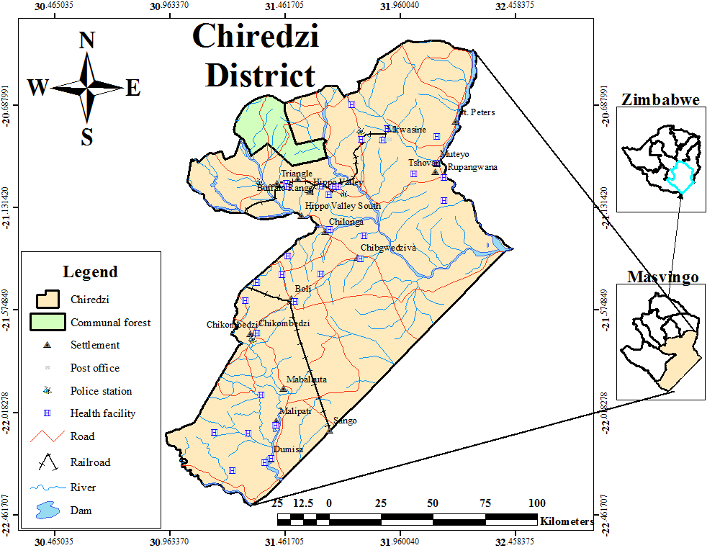
Map.4 Road/Rail Corridor

Slide 29
Infrastructure continue….
Health facilities
We have 11 operational clinics, 1 ready for opening and 9 still under construction
Education facilities
Primary schools 113; 58 are registered and 55 satellite schools
Secondary Schools 28; 8 are registered and 20 satellite schools
Recreation
Gonerazhou National Parks, Malilangwe Trust
Triangle and Hippo Valley Country Club
Natural pools and Gorges such as Pesvi Gorge, Chivilila Gorge, Chipinda pools, Ross pool
Electricity
The infrastructure covers the whole district.

Slide 30
Land Tenure And Ownership Terms
Land ownership- State, Council and Private. The principal owner of the land is the sate.
Land allocation: Council allocates land and the state also allocate land to the developers.
Land Availability: The is still land available more than 8000 hectares available.
Characteristics of the property market- There is high demand for irrigation land (eg sugarcane farming)

Slide 31
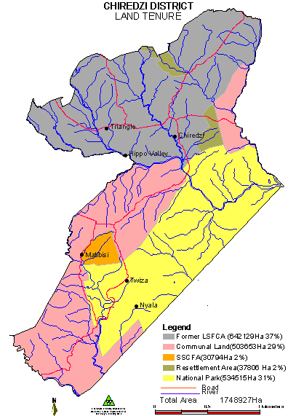
Map 2: Land Tenure

Slide 32
Environmental Legislations Enabling Or Disabling To The Sustainability Of The Local Economy
The District has an environmental by law Statutory Instrument 122/2016
Climate change adaptation issues in relation to environmental resources.
Increased drought intensity and frequency
Increased prevalence of flood incidences
Heat waves
Various adaptation and mitigation strategies are being implemented to build resilient communities. Coping with drought, scaling up climate change adaptation and ECRAS are some of the projects which have been implemented in the District.
Degradation -Natural land degradation is so common with most areas being reduced to Dongas and gullies. The soils are very loose and flash floods have become more frequent.

Slide 33
SWOT Analysis
Strength River network or water bodies Rich basaltic soils Flat land Wildlife species Transport network | Weaknesses Harsh climate Lack of adequate infrastructure Land degradation Siltation High level of dependence syndrome Gender inequality in development
Opportunities Tourist attraction Improved marketing due to good road and communication networks High heat temperatures Tugwi Mukosi Agriculture development GLTFCA | Threats Poachers Cattle Rustlers from Mozambiques Cholera HIV and AIDs GBV Malaria Floods Droughts Climate change Bleeding Mirco economy (black market) Fuel Shortages

Slide 34
LOCAL ECONOMIC DEVELOPMENT
Chiredzi Rural District Council plans to implement the following rural development measures financed by council in partnership with other development partners and investors
Improving the competitiveness of the agricultural and forestry sector;
setting up of young agricultural producers;
support for advisory system and services;
modernisation of agricultural holdings;
improving the economic value of forests and adding value to forestry products;
adding value to agricultural and non-wood forestry products;
development of new products, processes and technologies in the sectors of agriculture(Sugar Industry), food and forestry;
infrastructure of agriculture and forest management;
setting up and development of producer groups

Slide 35
Continue
Improving the environment and the countryside
support for agricultural land; agri-environmental support;
support for organic production;
support for keeping animals of local endangered breeds;
support for growing plants of local varieties;
support for the maintenance of semi-natural habitats;
animal welfare: support for grazing animals; non-productive investments.
The quality of life in rural areas and diversification of the rural economy
diversification of the rural economy ;
diversification into non-agricultural activities;
support for business development(mining and beneficiation, conservation and tourism, hotel and catering industry);
village renewal and development (basic services for the economy and rural population, village renewal and development, conservation and upgrading of the rural heritage entrepreneurship).

Slide 36
Drivers To Economic Growth in detail
Expansion in Agriculture and conservation
More irrigation projects, irrigation as a source of additional income for further investment in the district and as a form of employment to increase number of economic active people and improve the GDP.
We have river networks , water bodies like Tokwe Mkosi and Marenje dam and rich good soils for citrus farming (e.g. oranges, mangos). And also research station to protect our crops from diseases.
Because of our terrain and region, to sustain the irrigation projects through out the whole year more dams, carnals need to be constructed.
Invest more in fishery projects, piggery and poultry projects.
Our climate is suitable for fishery, piggery and hen projects. A small Fishery project running at the moment has proven to be successful and the Chilonga people has been benefiting from it (owned by Community Share ownership partnering with private organisations).
Community development is easy in functional communities.

Slide 37
continue......
Extension in Wildlife ventures and Tourism- improve foreign currency inflow
Partner with parks, in protection of the big 5 species from poachers (receive more revenue from trophy fees) and encouraging visitors to use our access networks
The District is home to the mighty Gonarezhou National Park with all the big 5 game and it forms part of the Great Limpopo Transfontier Park ( GLTP) thus one of the biggest wildlife park in the world.
We have railway networks and air networks (Buffalo Range international airport) to transport people from one place to another that need to be refurbished. Non functional airstrips such as Muteyo, Chibwedziva, Boli, Malipati and Davata that exist need to re-opened to increase more air access routes to our district.
Since we share the international borders with South Africa, Mozambique; visitors from neighboring countries can visit our district using our road networks. Our roads need to be maintained and resurfaced for easy access.

Slide 38
Continue
Introduction of cultural dances, unique traditional architects at tourists attraction sites as part of (tourists attractions).
Revamp some of our natural pools attractions like Sekela Hot Springs into attractive camping or resting sites(eco-tourism).
Council can work together with Zimbabwe Tourism Authority to market these small attractive camping sites to all district visitors.
Cultural events (improve cash inflow )
We are a multi cultural district Shangaan, Shona, Ndau, Venda, Pfumbi. We can host quarterly national cultural events in partner with our district national parks like Gonarezhou and Malilange.
Livestock Ranching Community Project.
Encourage community livestock ranching projects
Our district people are more into farming and livestock ranching. Small community livestock ranching projects will yield good results. The livestock will be converted into real wealth for further investments in the district and community developments.

Slide 39
Challenges
Bleeding micro-economy(black market)- Chiredzi shares borders with South Africa and Mozambique; because of our bleeding economy , there is high smuggling of goods in the district that is promoting informal trading and black market. Formal traders are failing to compete with informal traders which is a threat to new entrepreneurs to establish their business and it has also become difficulty or rather impossible to collect revenue from informal traders.
Most formal traders are no longer operating. Due to that our revenue inflow have reduced affecting our projects.
Harsh climate and Floods- Because of frequent floods there is constant land degradation in some areas and more deaths records because of the Chilonga bridge. Chilonga bridge should be functional because it is one of the tourists entrance gates to parks. There is need to construct a bridge.
Malaria zone (Health)- Chiredzi District is a malaria zone and it is one of the districts with high infected rate of HIV/AIDS. In the past years it has reported cholera deaths in some areas. Because of that some investors or tourists are afraid to use our access networks.

Slide 40
Continu…
Council should introduce ways to avoid the visitors from being affected by malaria(dispensing malaria pills to visitors) and build 5 star rated camping/resting sites within the district which needs a lot of money.
Land ownership- The Jambanja 2000 issue has resulted in illegal settlers. The settlers has no security of land tenure and this has been affecting major investments in our district. Land ownership should be clear and known to attract more investors.
Power shortages- Because of power shortages irrigation projects need solar systems. Installation of solar systems is expensive which is one of the council setbacks in promoting extensive irrigation farming around the district.
Education levels- 92% of the population is literate but only 3% reached tertiary level. This is one of the reasons the poverty level is 67.2%. From the survey most highly paid people and employed are not from our district. People within our district should be encouraged to go to school and get skilled so that they will be able to manage their community projects and decrease the poverty level.

